Slide 1


Slide 2



Slide 3
PCARS History
2005 – 2015
The first 10 Years

Slide 4
Why Part 4?
There have been 3 other PCARS History presentations over the years. And, there will be more in the future.

Slide 5
Over the next 3 hours, I’ll dive into the History of PCARS from 2005 through 2015

Slide 6
Ya – right -
There is no way that 10 years of PCARS history can be covered in only 30 minutes. PCARS is JUST TO BUSY HAVING FUN
So – I’m just going to hit some high points.
PLEASE – go back and look over the club newsletters – they are all available on the PCARS web site. By looking over the RADIOGRAM – you will see just how much FUN we have here at PCARS

Slide 7

Check out the PCARS newsletters
See all of our club activities over the years

Slide 8

Located on the club website:
www.portcars.org
All the details of our accomplishments and the FUN we’ve had is well documented and worth the time to review

Slide 9
August 2005 – KB8UUZ, KB8VJL, WB8LCD and KC8PD discussed the possibility of starting a new radio club that would promote more fun with Amateur Radio.
During October there were two meetings and after much consideration the decision was made to start a new club and have new goals.
The Constitution and By-laws and the club Mission Statement were written up. Incorporation papers were submitted and preliminary paperwork completed.

Slide 10
November 14, 2005 – the Portage County Amateur Radio Service, Inc. was officially born at a meeting held at Mike’s place in Kent.
The Constitution / By-Laws and Mission Statement had all been reviewed & approved.
We had at this time 9 paid up members for 2005 with 10 paid for 2006.

Slide 11
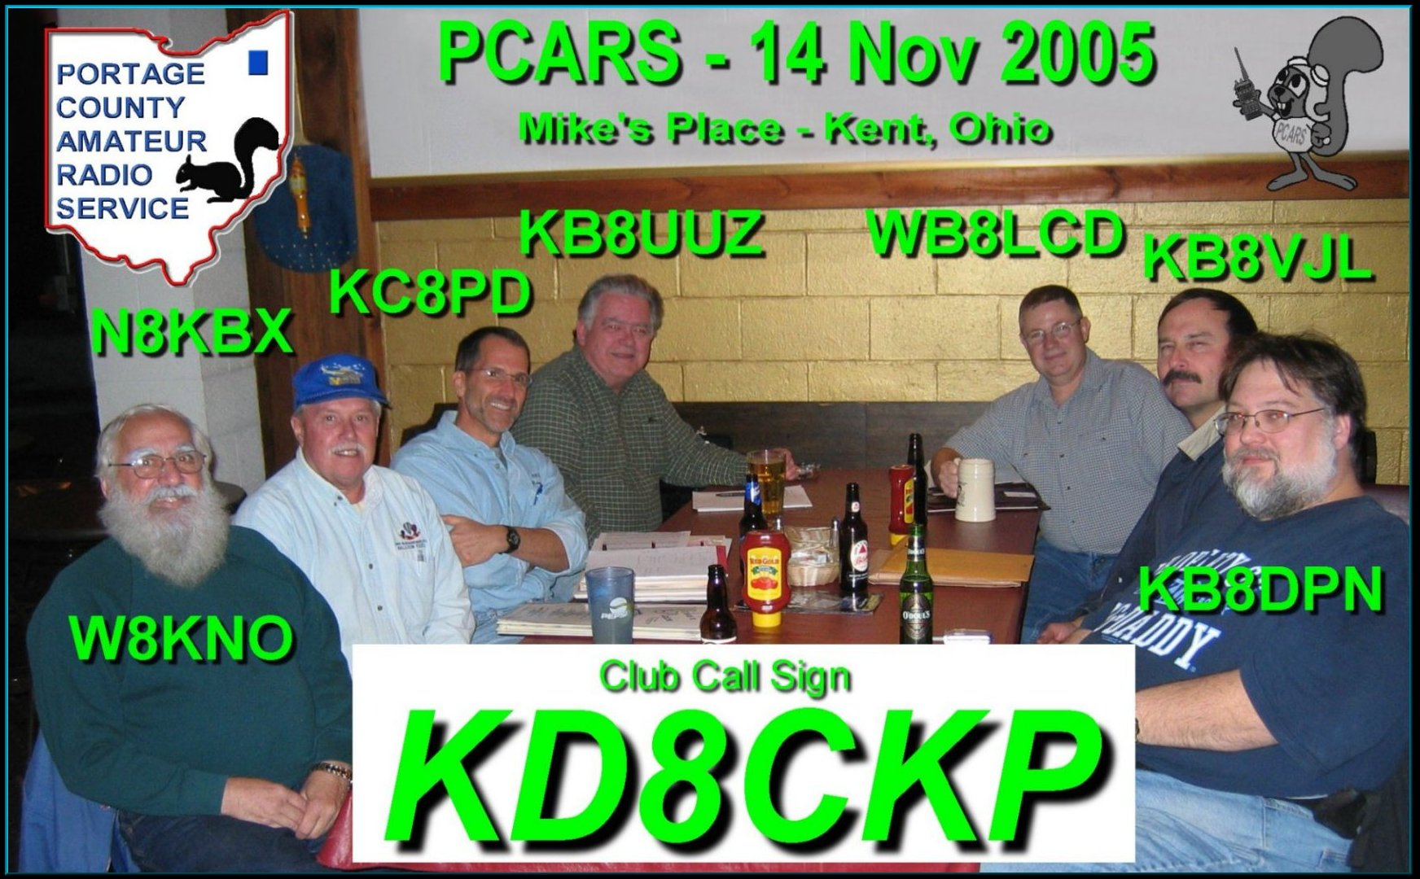

Slide 12
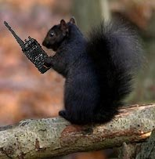
Why the Black Squirrel in our logo?
The Black Squirrel is commonly seen around
Portage County, Ohio.
Seems that some of these little guys &
gals got loose from
Kent State University
back in 1961 and have migrated
and thrived throughout our county.

Slide 13
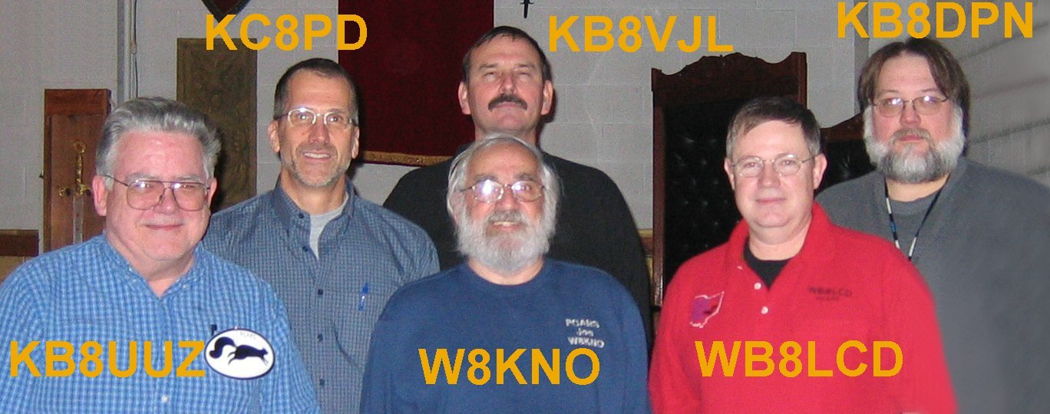
November 14, 2005 - Our first Officers were elected:
WB8LCD – President
KC8PD – Vice President, appointed as PIO
KB8UUZ – Treasurer, appointed as Secretary
KB8VJL – 3 Year Trustee, appointed as Club Call Trustee
W8KNO – 2 Year Trustee
KB8DPN – 1 Year Trustee, appointed as Webmaster

Slide 14
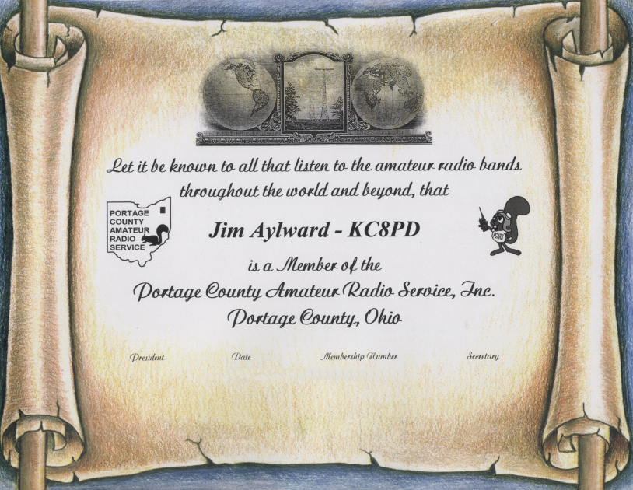
A Member Certificate was designed and is still in use today.

Slide 15
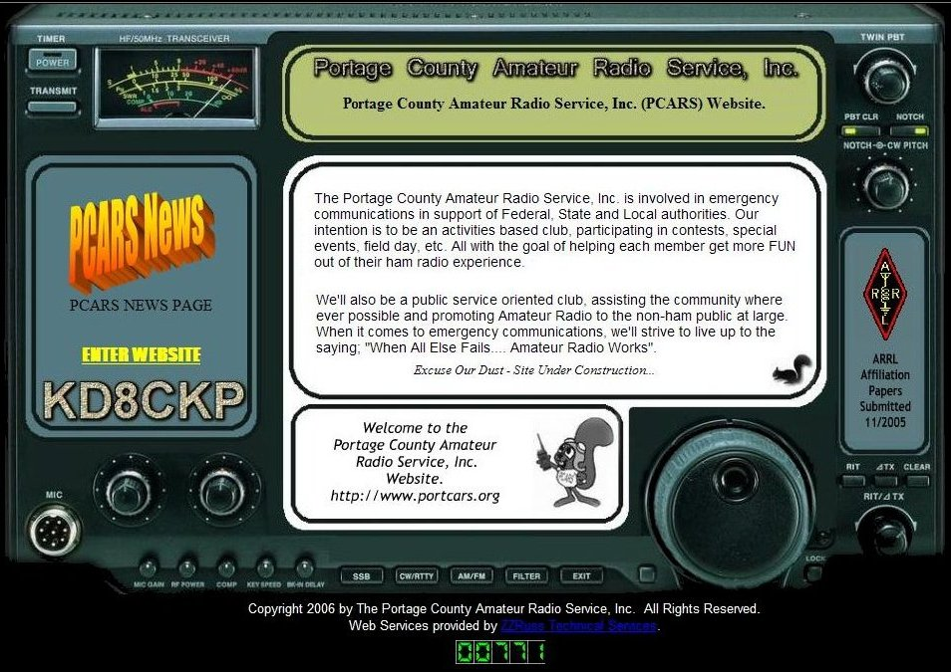
Our club call sign arrived: KD8CKP
The web site domain name
WWW . PORTCARS . ORG
was obtained & the web site went on-line.

Slide 16
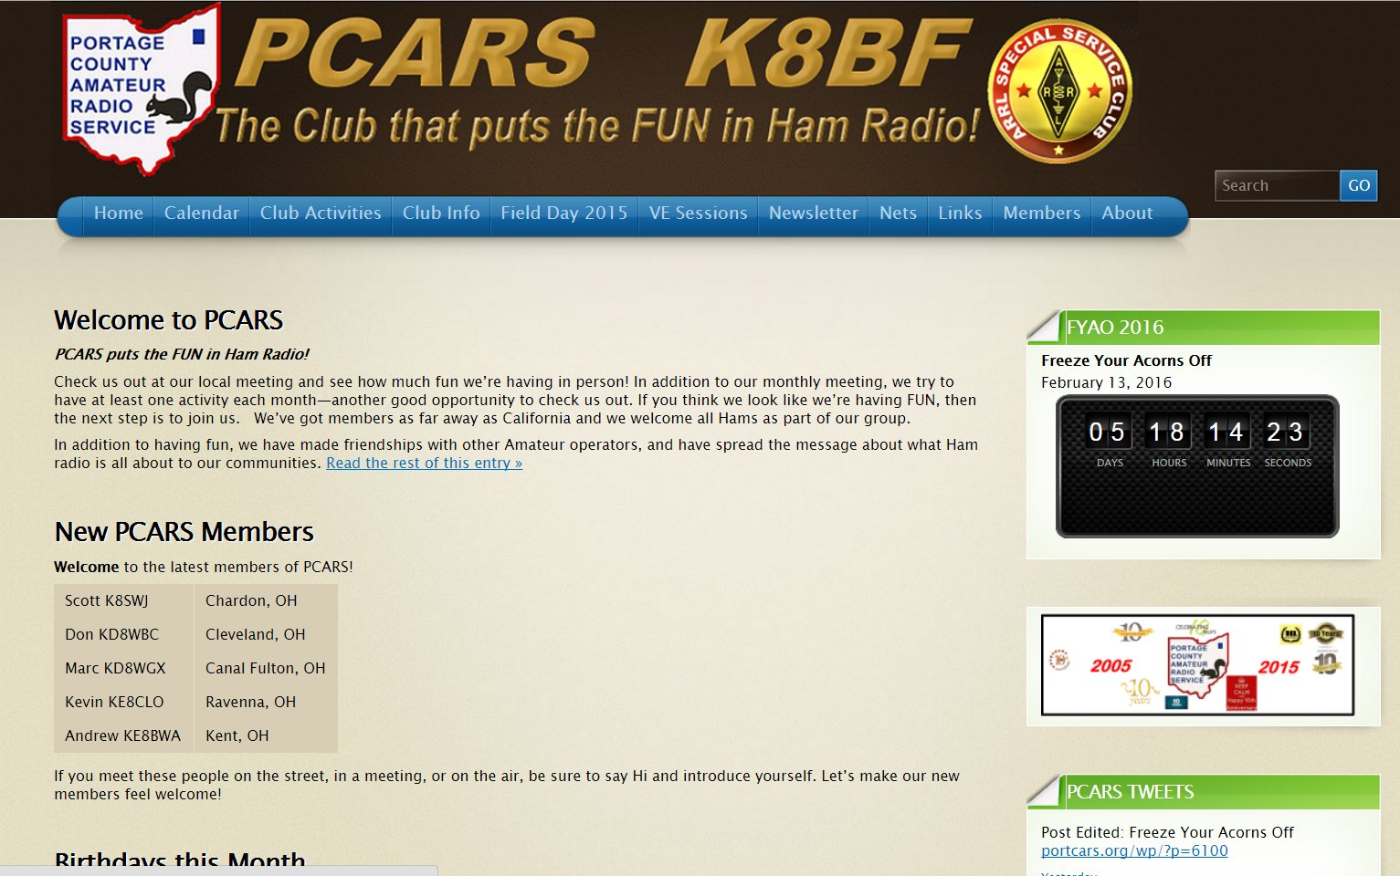

Slide 17
Permission was obtained to use the Kent Repeater on 146.895 for club nets. A net control schedule was set for the next few months and our first 2 meter net was to be held on January 5th.
December 2005 – During December a few more people heard about the new club and immediately sent in dues for 2006 and our membership was up to 12.

Slide 18
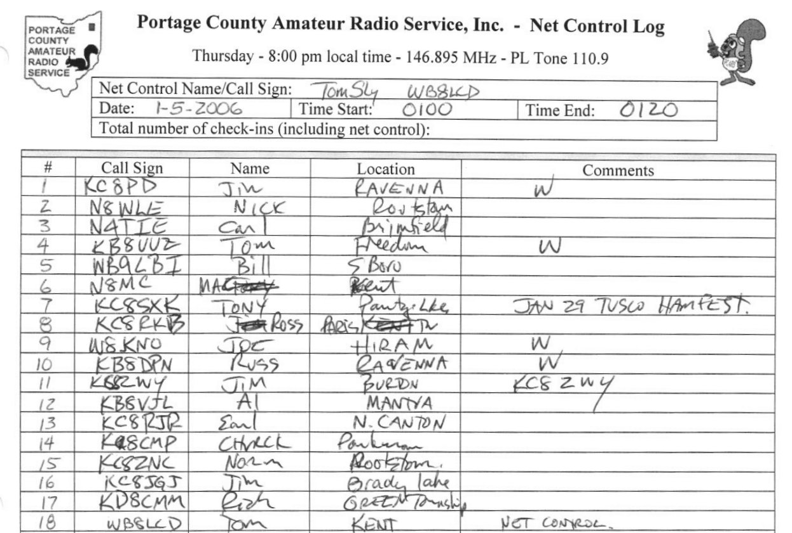

January 5, 2006 – the First PCARS 2 meter net was held at 8 pm on the Kent repeater and there were 18 check-ins.

Slide 19
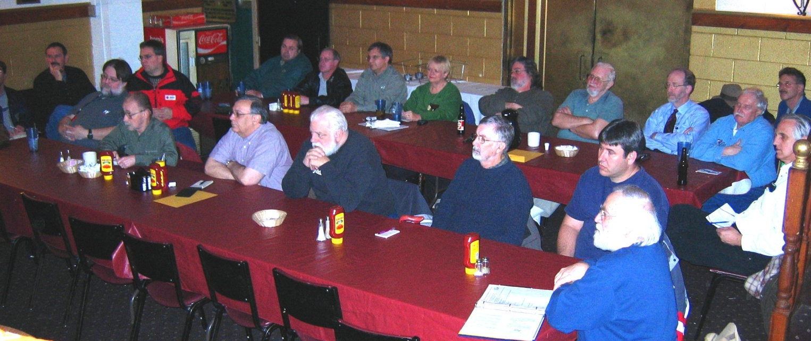
January 9, 2006 was PCARS first full meeting
The meeting started promptly at 7:00 pm and there were almost 40 people in attendance!
During the evening 12 new members signed up bringing the total to 26.

Slide 20
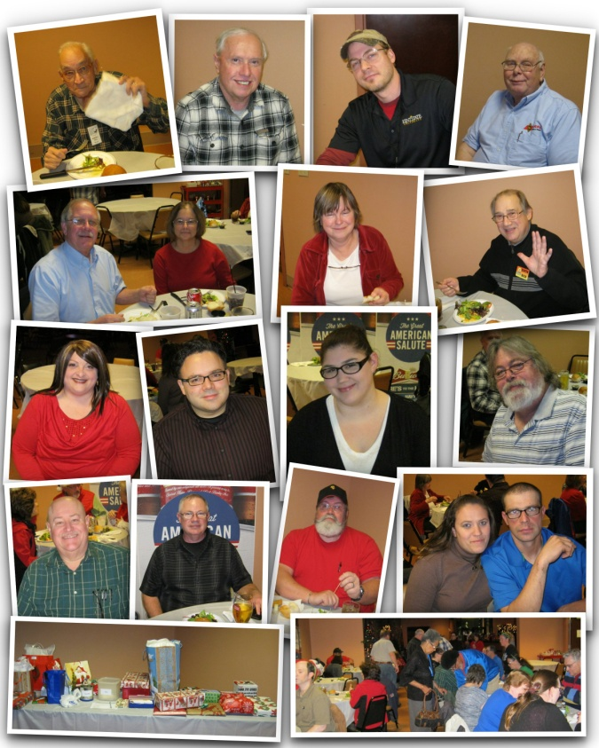
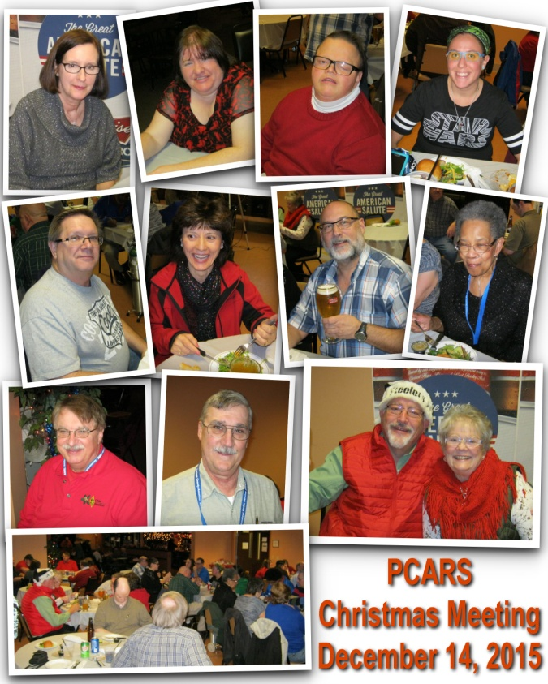
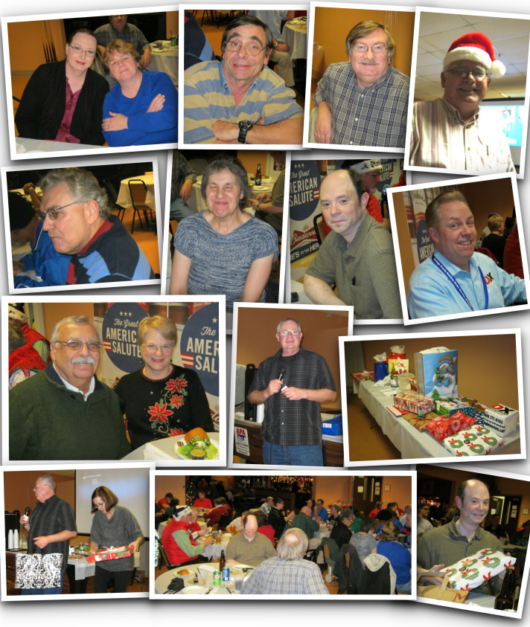
December 2015 meeting
Membership has grown over the years and the latest membership number issued is 314

Slide 21
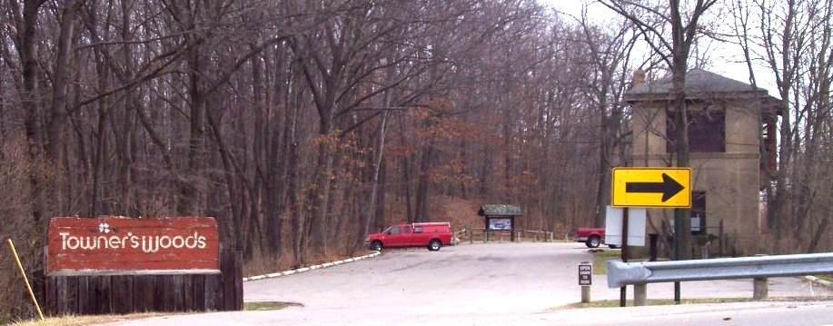
February 25, 2006 – the first F.Y.A.O.
At Towner’s Woods Park

Slide 22
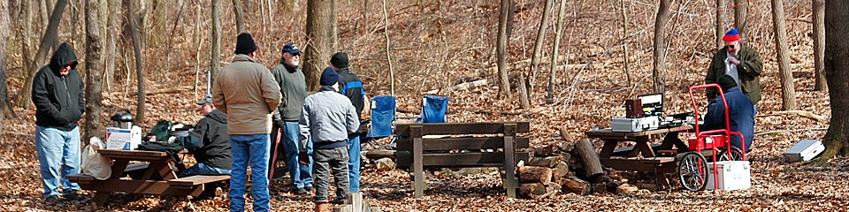

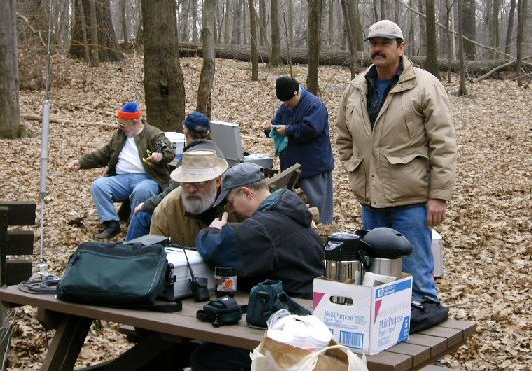
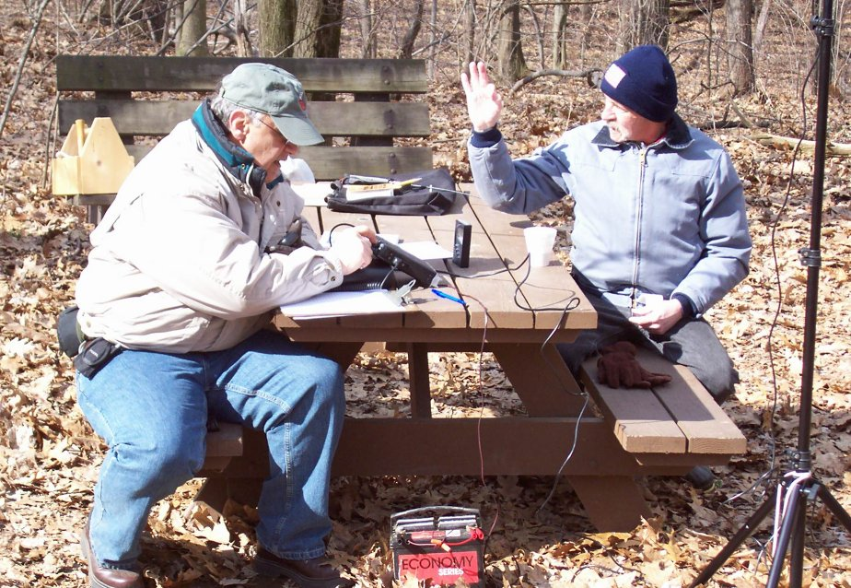
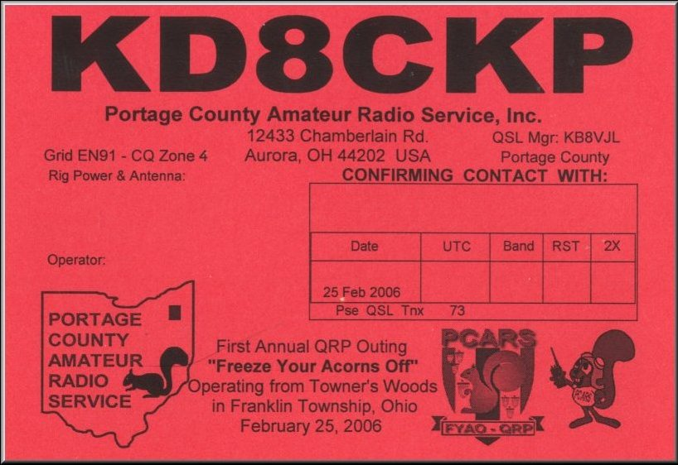
16 Attendees
WB8LCD, KB8UUZ, KC8RJR, WB8FEW, KB8DPN, K8CMP, KC8JGJ, KB8VJL, W8KNO, KB8JHS, N8KBX, N4TIE, WB9LBI, AB8IE, AB8UD and Megan

Slide 23
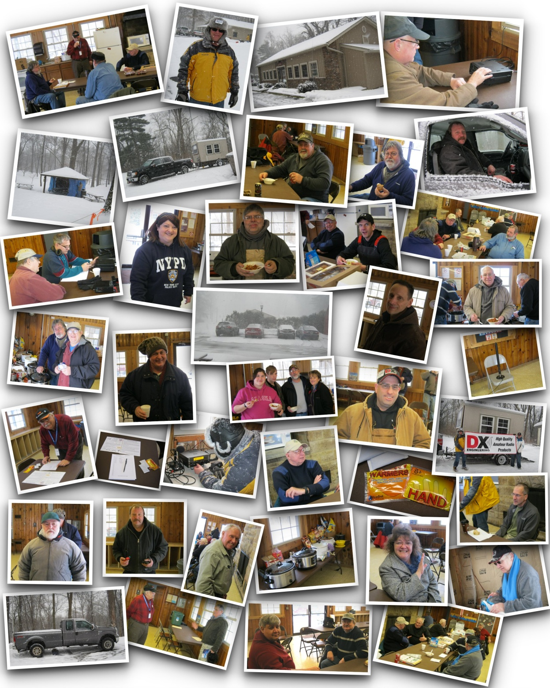
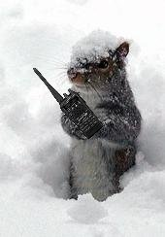
February 14, 2015
10th F.Y.A.O.
At Fred Fuller Park in Kent

Slide 24
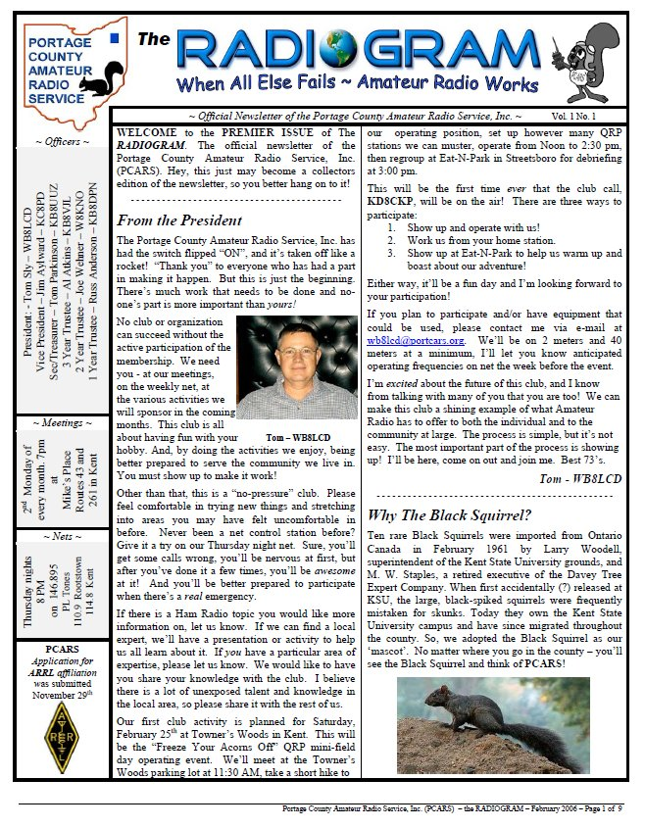

The first monthly newsletter
was out on February 1st 2006 and had 8 pages
The January 2016 newsletter had 51 pages

Slide 25


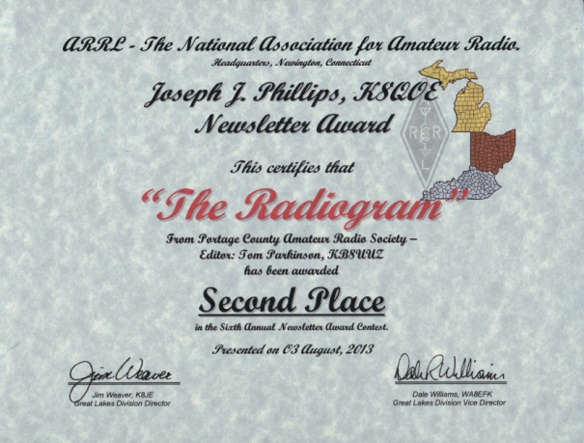
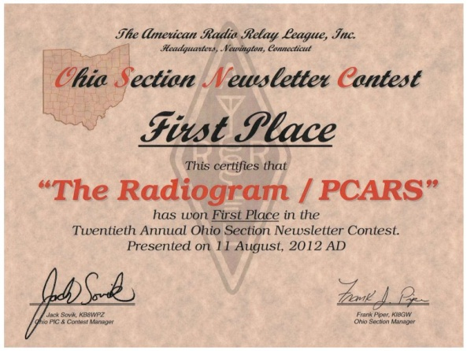
Our club newsletter - has been awarded:
ARRL Ohio Section Newsletter First Place Winner for 2012 AND 2013
Second Place in the Great Lakes Division for 2013 Second Place ARRL Ohio Section Newsletter for 2014 Third Place Winner in the Ohio Section 2015

Slide 26
PCARS Charter Members
Charter membership was promoted from January 1st until March 13th 2006
Thirty-Seven members will forever be known as PCARS Charter Members

Slide 27
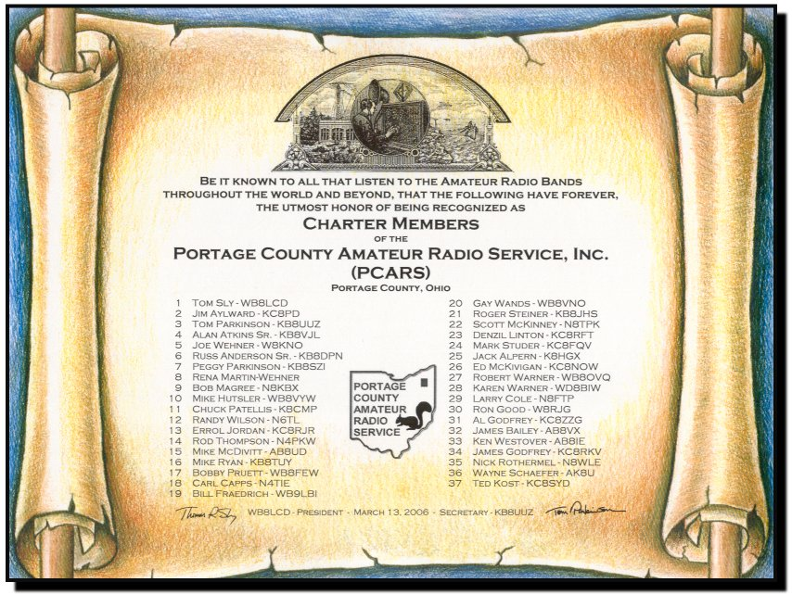

Slide 28
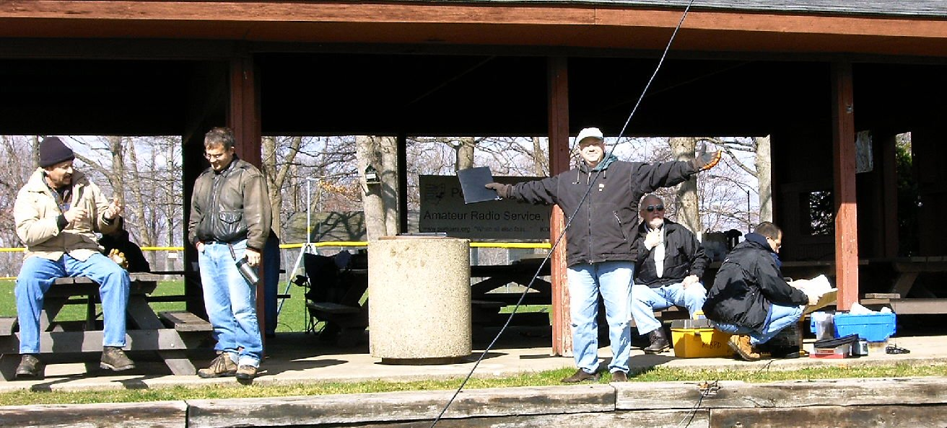
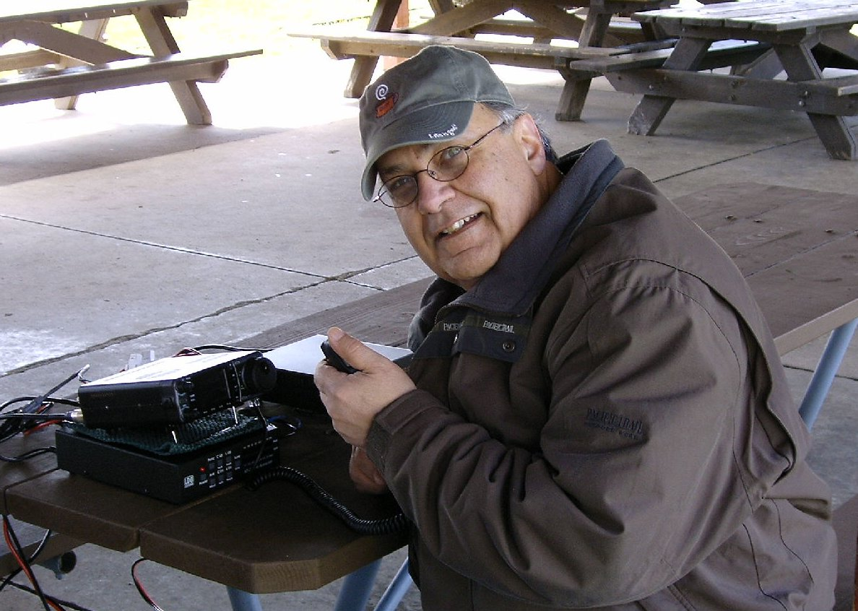
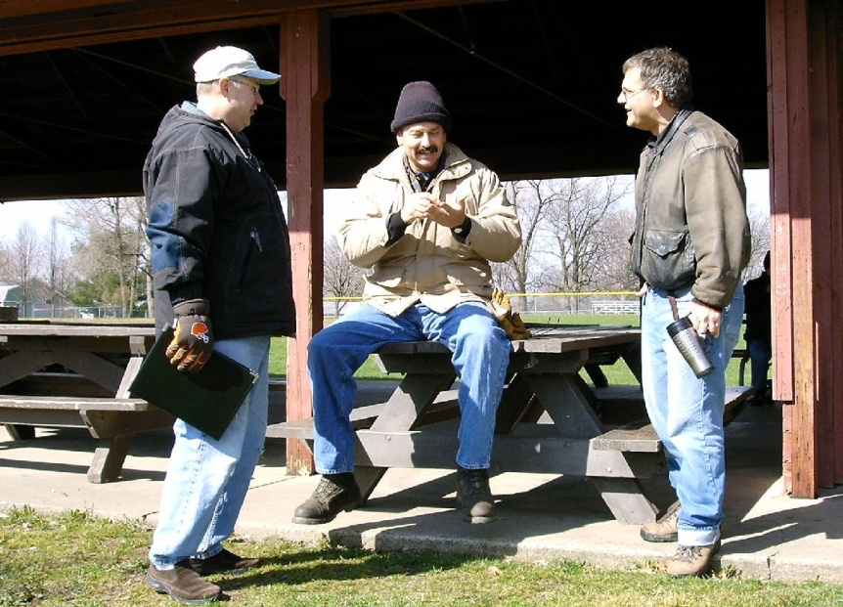
April 8th – the first Antenna Day at the Ravenna City Park

Slide 29
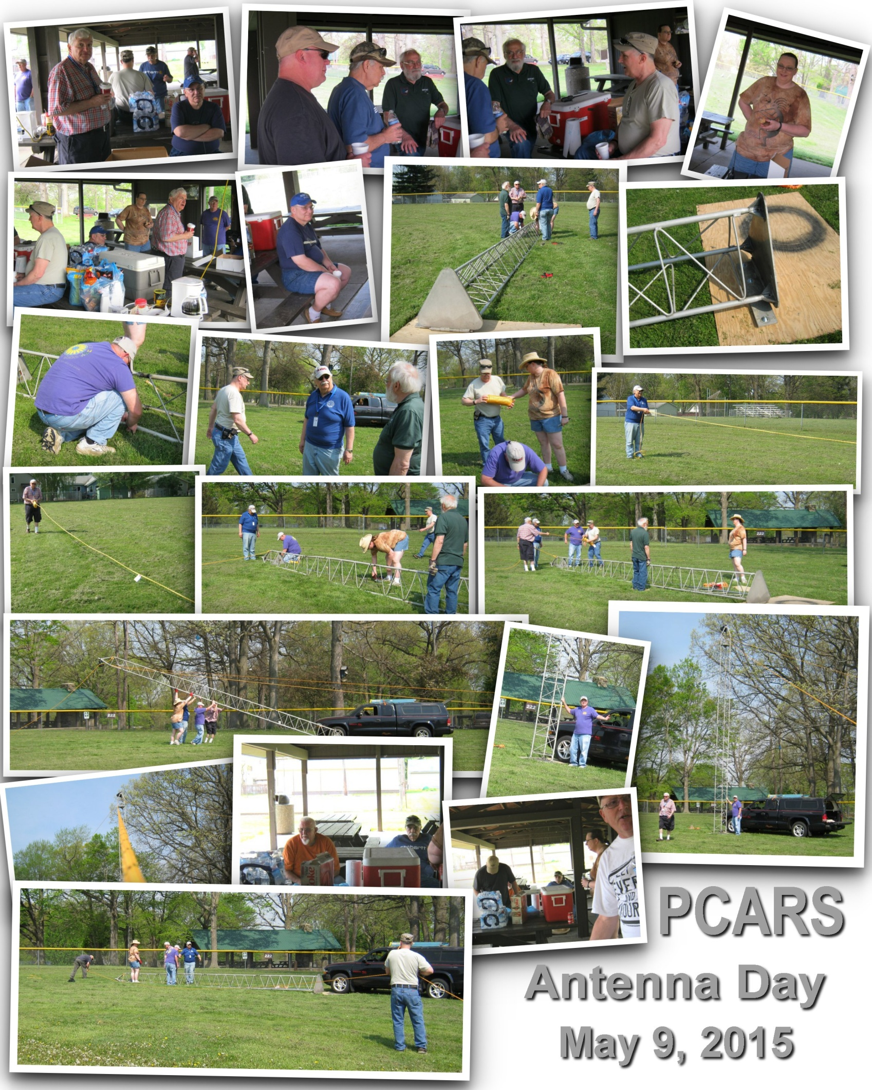
May 9th – 2015 Antenna Day at the Ravenna City Park
Beautiful weather.

Slide 30
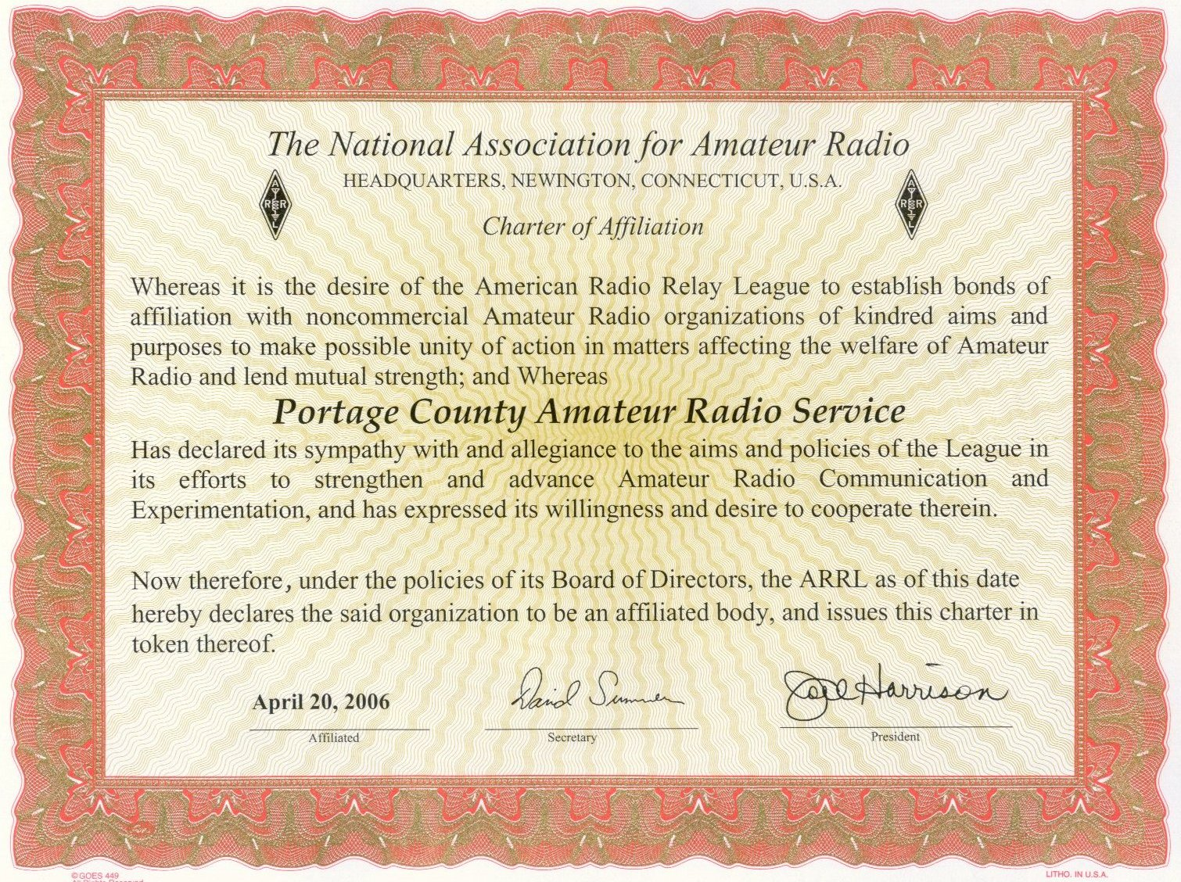
April 20, 2006 – ARRL Affiliation

Slide 31
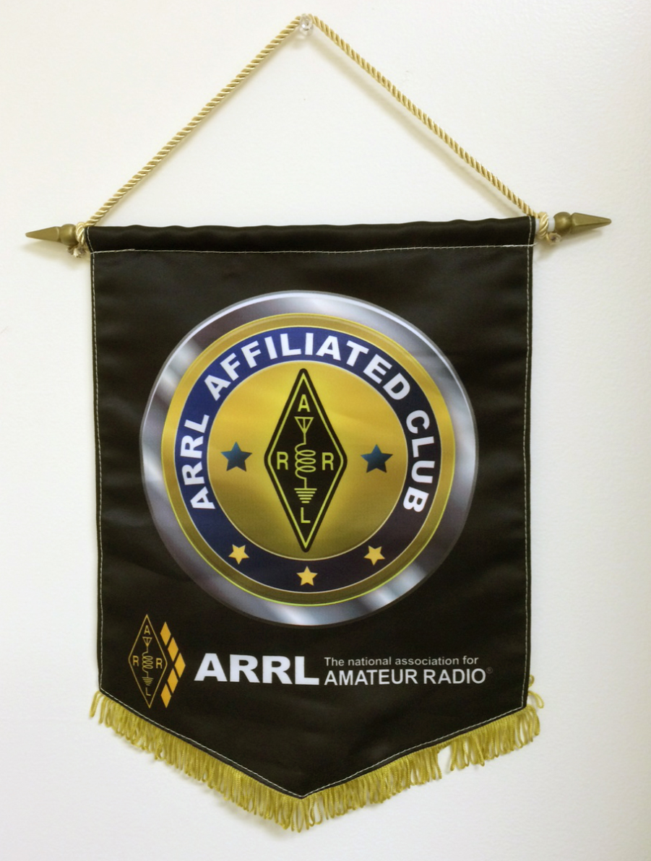

April 20, 2006 – ARRL Affiliation

Slide 32
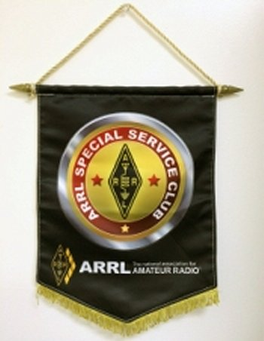

March 22, 2010 – ARRL Special Service Club

Slide 33
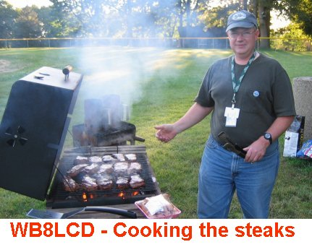
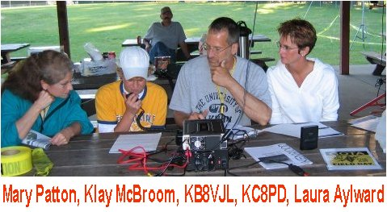
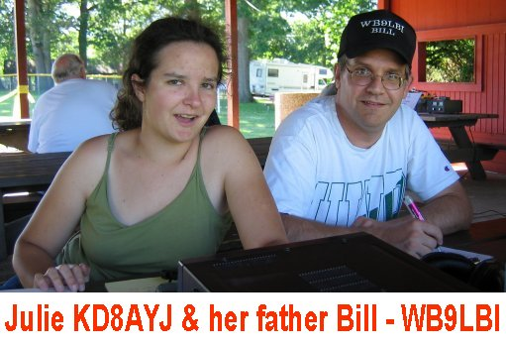
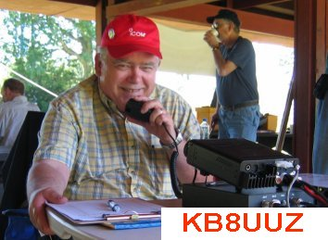
June 24-25th 2006 – our first FIELD DAY

Slide 34
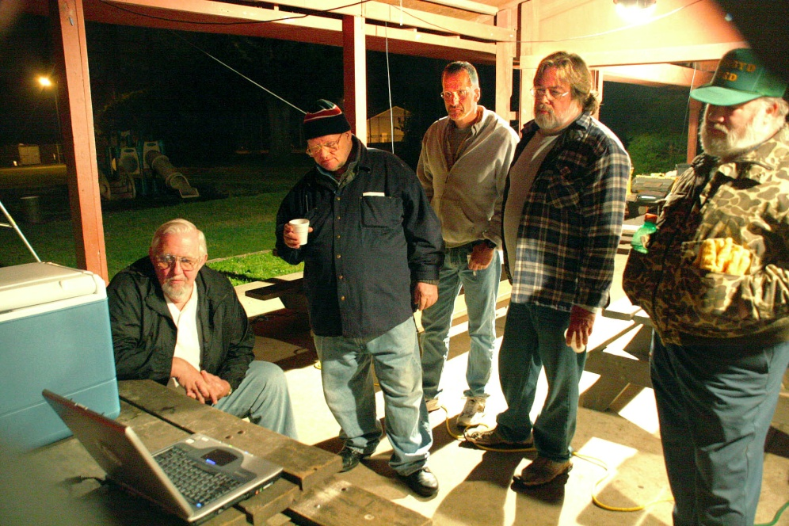
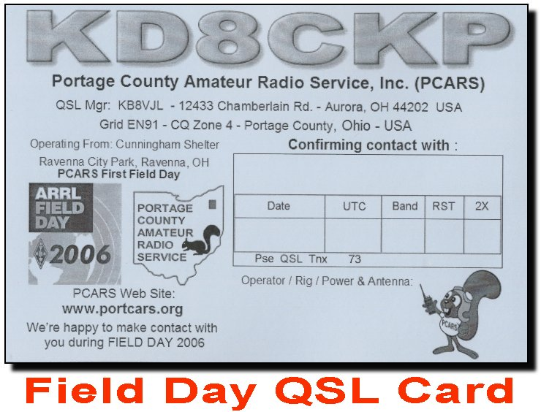
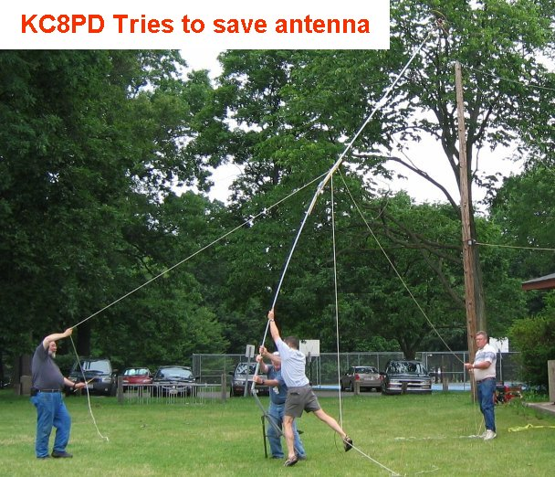

June 24-25th 2006 – FIELD DAY
28 PCARS members - Class 3A 32 Visitors – 455 QSOs –
2,232 points.
14th in Ohio,
23rd in GLD,
142nd overall.

Slide 35
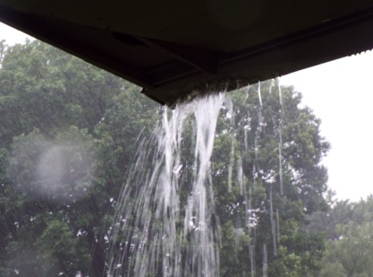
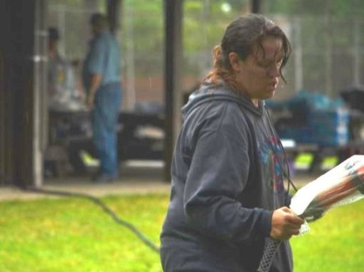
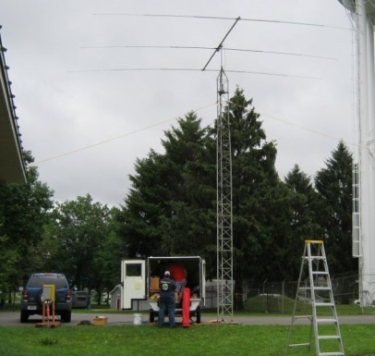
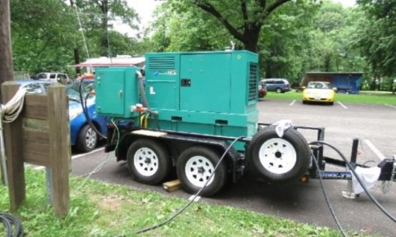
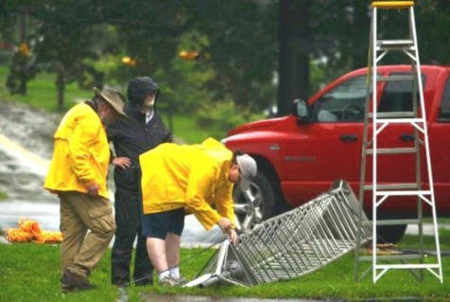
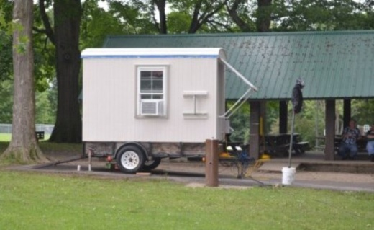
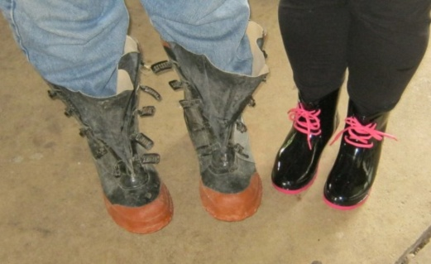
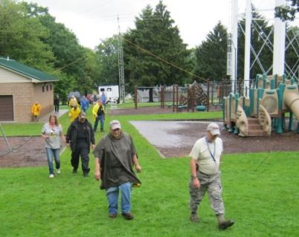
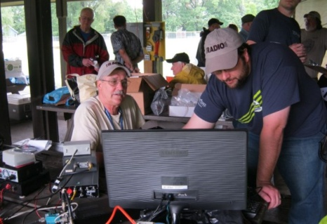
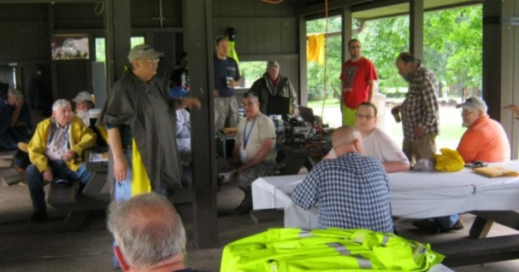

June 27-28th 2015 – FIELD DAY
98 PCARS members - Class 4A 2,778 QSOs – 8,990 points.
4th in Ohio,
5th in GLD,
69th overall.

Slide 36
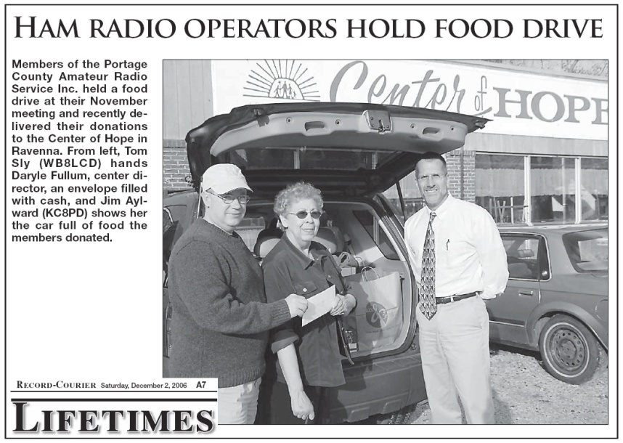
November 16th 2006 – Center of Hope donation
WB8LCD and KC8PD delivered a car load of groceries and a check for nearly $300.00 to the Center of Hope

Slide 37
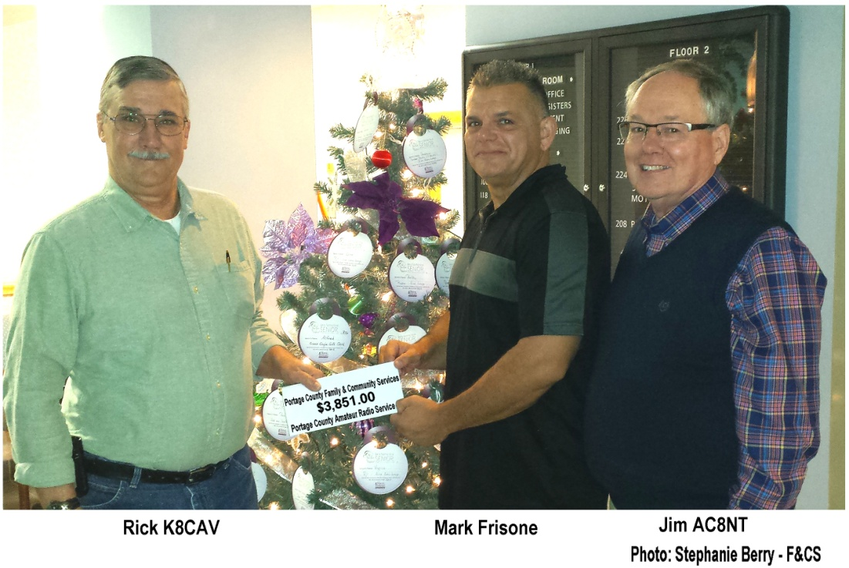
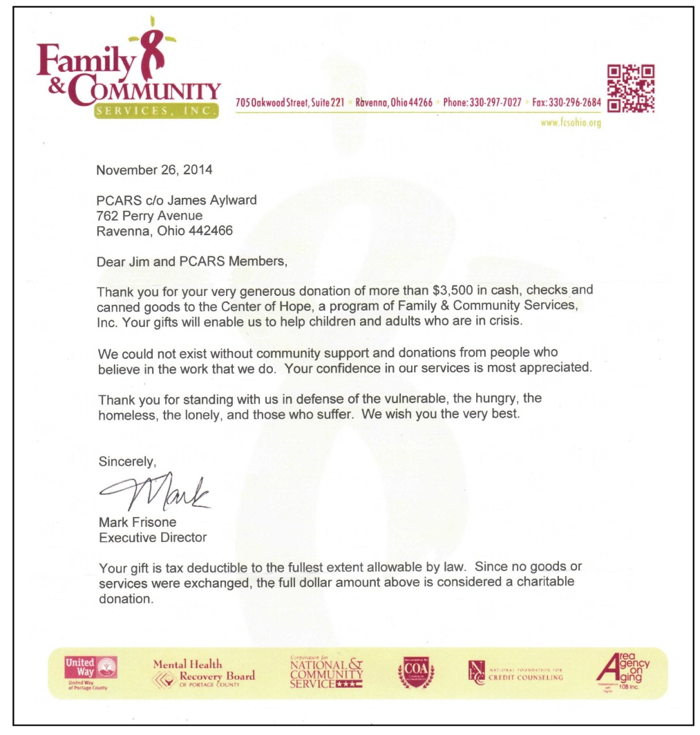
December 2015 – Center of Hope donation
K8CAV and AC8NT delivered a check for over $3800.00 to the Center of Hope

Slide 38
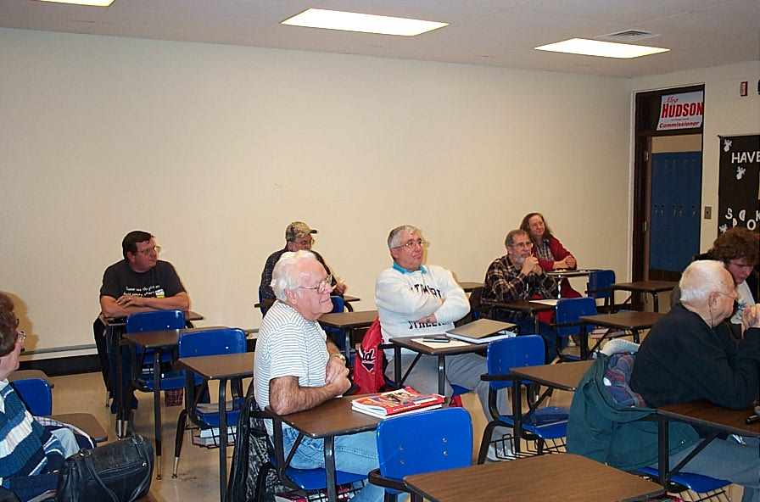

First Technician Class
Nine New Technicians
Volunteer instructors were Russ Anderson – KB8DPN,
Tom Parkinson – KB8UUZ, Jim Aylward - KC8PD
and Tom Sly – WB8LCD.
The VE team consisted of Russ Anderson – KB8DPN,
Tom Parkinson – KB8UUZ, Jim Aylward - KC8PD
and Carl Capps – N4TIE.
Classes have continued for Technicians, General and Amateur Extras. Everyone associated with this teaching effort has been proud to say they are part of PCARS and encouraging new hams to help maintain this great hobby of Amateur Radio

Slide 39



As of the end of December 2006
PCARS membership was: 53
As of the end of December 2015
PCARS membership was over 185

Slide 40

And the
FUN keeps
on going

Slide 41


KC8PD | Jim | Aylward
KB8UUZ | Tom | Parkinson
WB8LCD | Tom | Sly
N8XTH | Deron | Boring
N8PXW | Jim | Korenz
N8QE | Bob | Hajdak
W8PT | Chuck | Patellis
K8IV | Ed | Polack
K8QF | Russ | Conklin
N8RLG | Robert | Gurney
KD8FLZ | Mike | DiCarro
WA8CCU | Al | Nagy
NR8W | Russ | Williams
W8EZT | Frank | Tompkins
N8OQQ | Bryan | Buchwalter
AC8NT | Jim | Wilson
K8MSH | Mark | Haverstock
KA8TOA | Greg | Ash
PCARS VE team has grown over the years. At last count
There have been over 80 VE sessions and 30 VEs.
PCARS currently has 18 active Volunteer Examiners

Slide 42





Building a portable vertical antenna
Weekend
Club
Projects
Always BIG FUN
Building a sound card interface

Slide 43



Nut Runner
Digital Workshop

Slide 44




LoTW
Antenna Building
Cables & Connectors
PAK 40 – Winding torroids

Slide 45





J-Pole Antennas
Satellite Demo
Portable Antennas

Slide 46





Copper J-Poles
QSL Cards
Spud Guns

Slide 47




VOMs
Antenna Construction
Soldering Connectors

Slide 48



Power Pole Boxes

Slide 49

C
R
U
I
S
E
I
N

Slide 50





Slide 51


Slide 52







2015

Slide 53



Makers Faire
April 2014 at KSU

Slide 54



Makers Faire – KSU – May 2015

Slide 55



Makers Faire Akron – September 2015

Slide 56




December 2009 – New Call Sign K8BF

Slide 57

May
2008
Jim, KC8PD came up with this idea and the club has been sponsoring this contest every year since
PCARS proudly announces the first Ohio State Parks On The Air Contest (OSPOTA) which will be held on Saturday, September 6, 2008, from the hours of noon to eight p.m. EDT (1600Z to 2400Z). Our members know that the number one goal of PCARS has been to create opportunities for amateur radio fun and this contest is our way of sharing that fun on a wider scale.

Slide 58


OSPOTA has been popular and continues to show growth in participation. Seeing how much fun it can be, other states have started their own parks on the air contests.
The ARRL looked closely at PCARS and used OSPOTA as a model for the 2016 National Parks On The Air event.

Slide 59



Slide 60



PCARS CLUB SITE
A number of PCARS members got together on April 28, 2007 at the old ODOT site for a Clean-N-Paint event. PCARS now has a radio site established at the old ODOT site - which gives us access to the 200 foot tower, two rooms and a garage area we can call our own and use for club activities.

Slide 61





Slide 62





Slide 63


Slide 64





Slide 65









OQP at the Club site - 2007

Slide 66





BTV Installation
Aug 2010
2 Meter Contest – August 2008
PCARS Logo November 2010

Slide 67




Tri-bander & Tower October 2010

Slide 68




Tower Upgrade
August 2014

Slide 69

Member Ham License Plates
From 5 to 50
We want MORE
A great way for YOU to be part of the history of PCARS

Slide 70






Clean Up Day – August 2015

Slide 71




2008
2007
2009
2010

Slide 72




2011
2012
2013

Slide 73


2014
2015

Slide 74

The following words were from David Sumner’s (K1ZZ) August 2007 editorial on page 9:
“A recent ARRL affiliate that emphasizes having fun in Amateur Radio is the Portage County (Ohio)
Amateur Radio Service (PCARS), KD8CKP.
If you don’t believe they’re having fun, visit
their Web site at www.portcars.org and take
a look at their outstanding newsletters! The
club has taken advantage of free program
material at www.arrl.org/multimedia to help
educate its new members about contesting and Dxing. Other recent programs dealt with the Military Affiliate Radio System (MARS), QRP, and a hands-on workshop building and testing HF antennas. Hats off to the PCARS!”

Slide 75






David Sumner’s (K1ZZ) visit to PCARS – September 2015

Slide 76
Annual President’s Award
2006 - KC8RJR, Errol Jordan
2007 - KD8EPA, Dan Porcase
2008 - N8EQJ, Ed Polack and WB9LBI, Bill Fraedrich
2009 - KB8TUY, Mike Ryan, KD8LDY, Russ Williams and
KD8FLZ, Mike DiCarro
2010 - KD8VT, James Andrews and K8SRR, Steve Randlett
2011 - K8CAV, Rick Kruise
2012 - K8FEY, Bob Hewett and N8QE, Bob Hajdak
2013 - KB8UUZ, Tom "Parky" Parkinson
2014 - KB8AMZ, Terry Morris - AC8NT, James Wilson and
KD8WZS, Zeb Smith
2015 - AC8QG, Nick Wagner and
KB3GXB, Jennifer Andrews

Slide 77




PCARS Meetings
Over the years, we keep getting more members, or the place of business we have meetings at closes .......
Mike’s Place – we out grew that venue
Center of Hope
Otto’s Lounge in Brimfield – they closed down....
Sideliners – reopened under the new name, then closed down.......

Slide 78




On Tap Grille – Stow – was okay – but we kept growing – not enough room for all the PCARS members.
Strings & Wings – Streetsboro – plenty of room – good wings. Owner got in trouble.
The doors were padlocked......
Presently at the The American Legion in Kent

Slide 79






2006
PCARS Picnics
2015

Slide 80






Ohio
B-B-Qso
Party

Slide 81





Net Nights at the Club Site
4th Thursday

Slide 82
And the
FUN keeps
on going

Slide 83

The more I worked on gathering information about the first 10 years of PCARS, the more I thought about an old TV Show – Cheers
PCARS is like Cheers – Everyone knows your callsign and you are always welcome
PCARS is a home away from home

Slide 84


Slide 85
PCARS – the next 10 years

Slide 86
It’s all up to you
Don’t let us ‘old timers’ down

Slide 87
December 2015 – KB8UUZ

